Slide 1
Brake Lights
Allyson Llacuna
Anuraj Dash
Lakshmi Menon
Samruddhi Hande
Suha Kazi
DSGN 1 Final Project

Slide 2
Introduction
Billions of people drive cars every day
Thousands of people are injured or killed as a result of road accidents
What can we do to make such a common activity safer for everyone?
What are we trying to do?

Slide 3
Problem Statement
Why is there such a high occurrence of road accidents?
What are the main causes of road accidents?
In particular, how do rear-end collisions occur?
Is driver error caused by an inherent design flaw?
Where is this design flaw?
How can we fix it?
What is the real issue, and why do we want to fix it?

Slide 4
Vehicle Accidents
Rear End Collisions
Hard Brake vs. Soft Brake
Brake Lights
Refining our problem statement

Slide 5
How can vehicle brake lights be redesigned to effectively differentiate between a hard and a soft brake?

Slide 6
Data Gathering
Interview Demographic
Interviewed people with a large range of driving experience
Equal gender ratio
Interview Questions
Open ended, and expanded based on subjects’ responses
Encouraged subjects to describe situations and how they felt during them
Observations
Master-Apprentice Model: Sat alongside drivers in their cars
How are we going to research the problem?

Slide 7
Analysis
Problems & Trends Identified:
Distractions while driving
Action-based slip
Drowsiness while driving
Rule-based mistake
26% of users said fatigue is a problem
Low brake-light visibility in diff. weather conditions
What did we find?

Slide 8
“dangerous”
“annoying”
“scary”
“shocking”
“too many times”
Notes:
Negative connotation with hard braking and rear end collisions/accidents

Slide 9
53%
of interviewees stated drowsiness or distraction as one of the main causes of road accidents

Slide 10
69%
of interviewees stated that brake lights are less effective or difficult to see in bright light or bad weather

Slide 11
Redesign
Initially put forward all our ideas, reasonable or not
Considered each idea individually, identifying pros and cons
Collected pros of each idea with each iteration and further developed them
Came up with our idea of an optimal redesign
How can we make the existing model better?

Slide 12
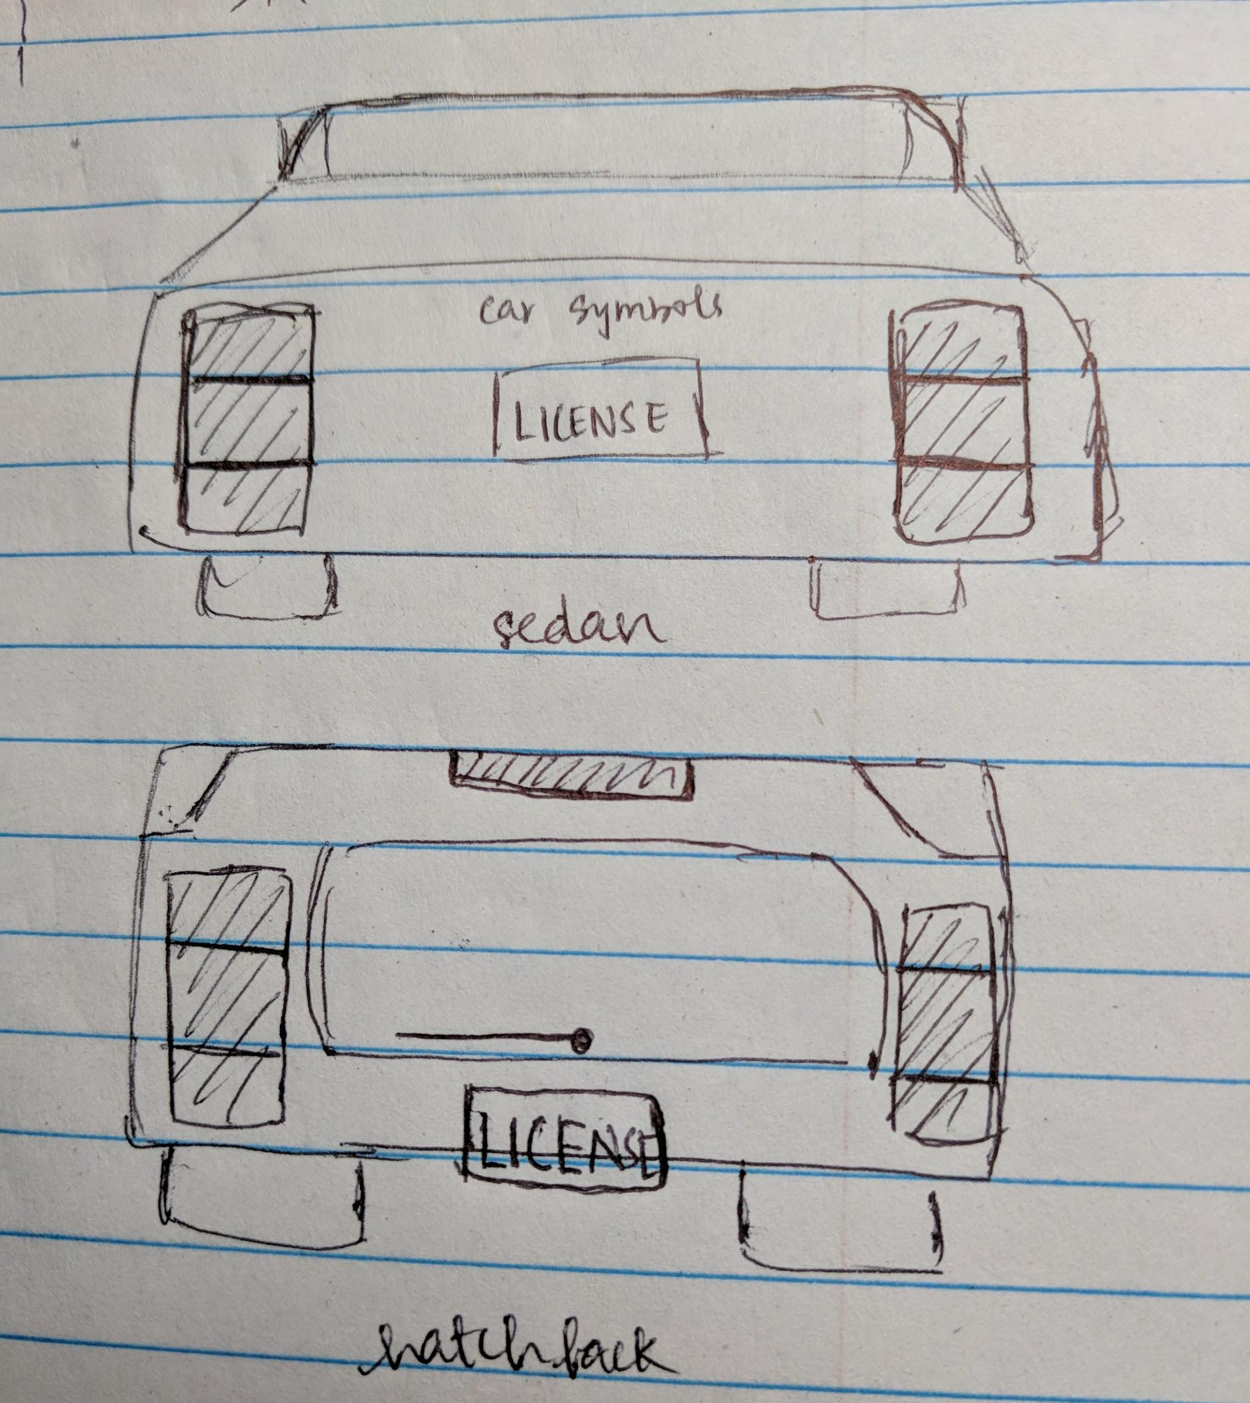
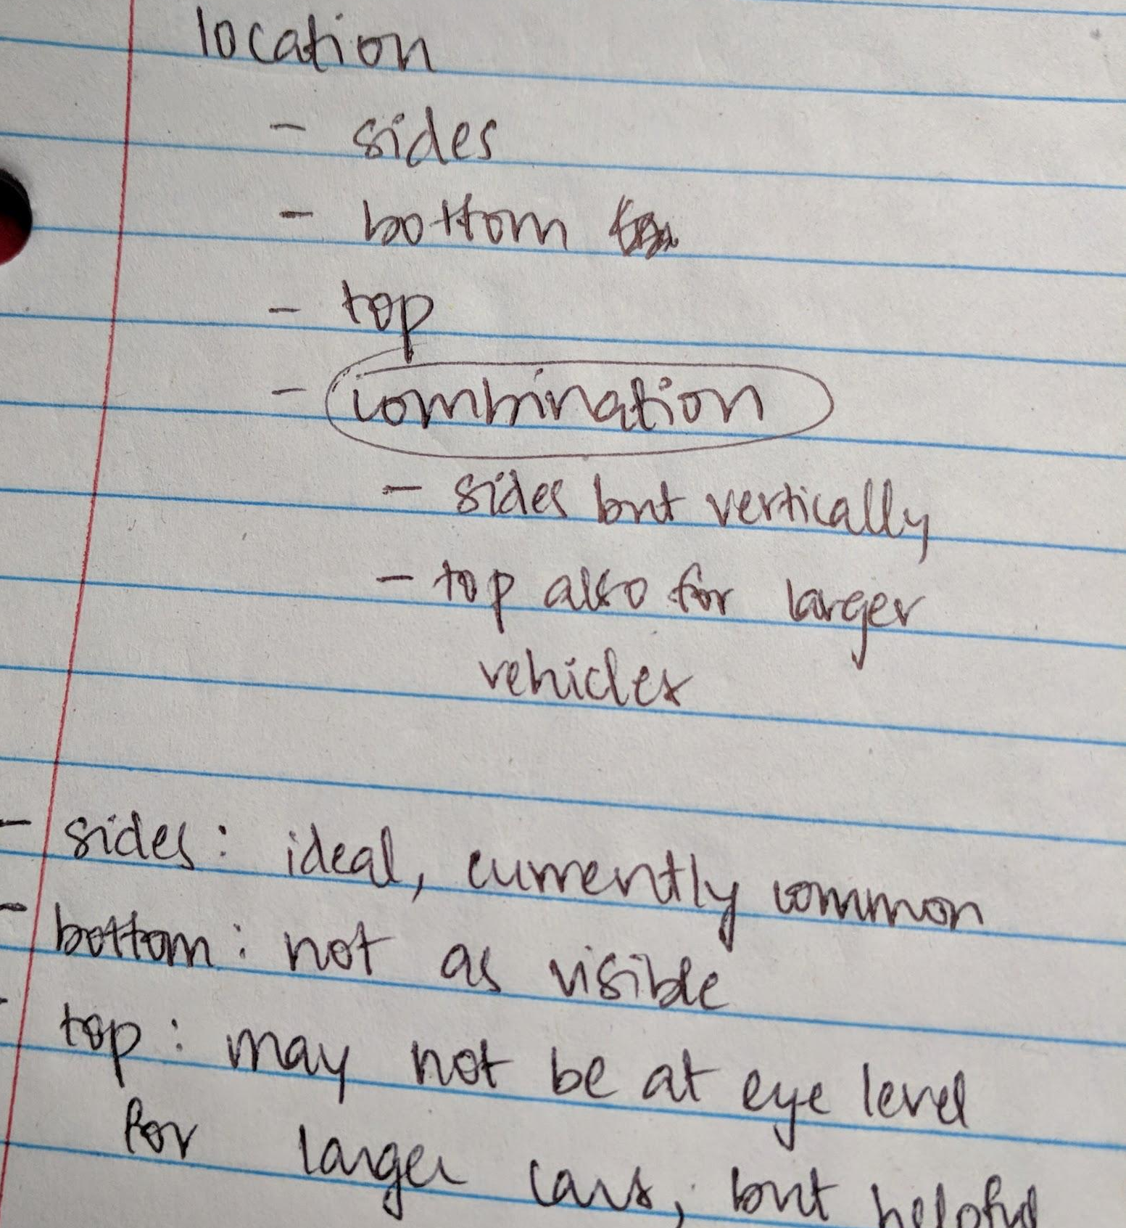
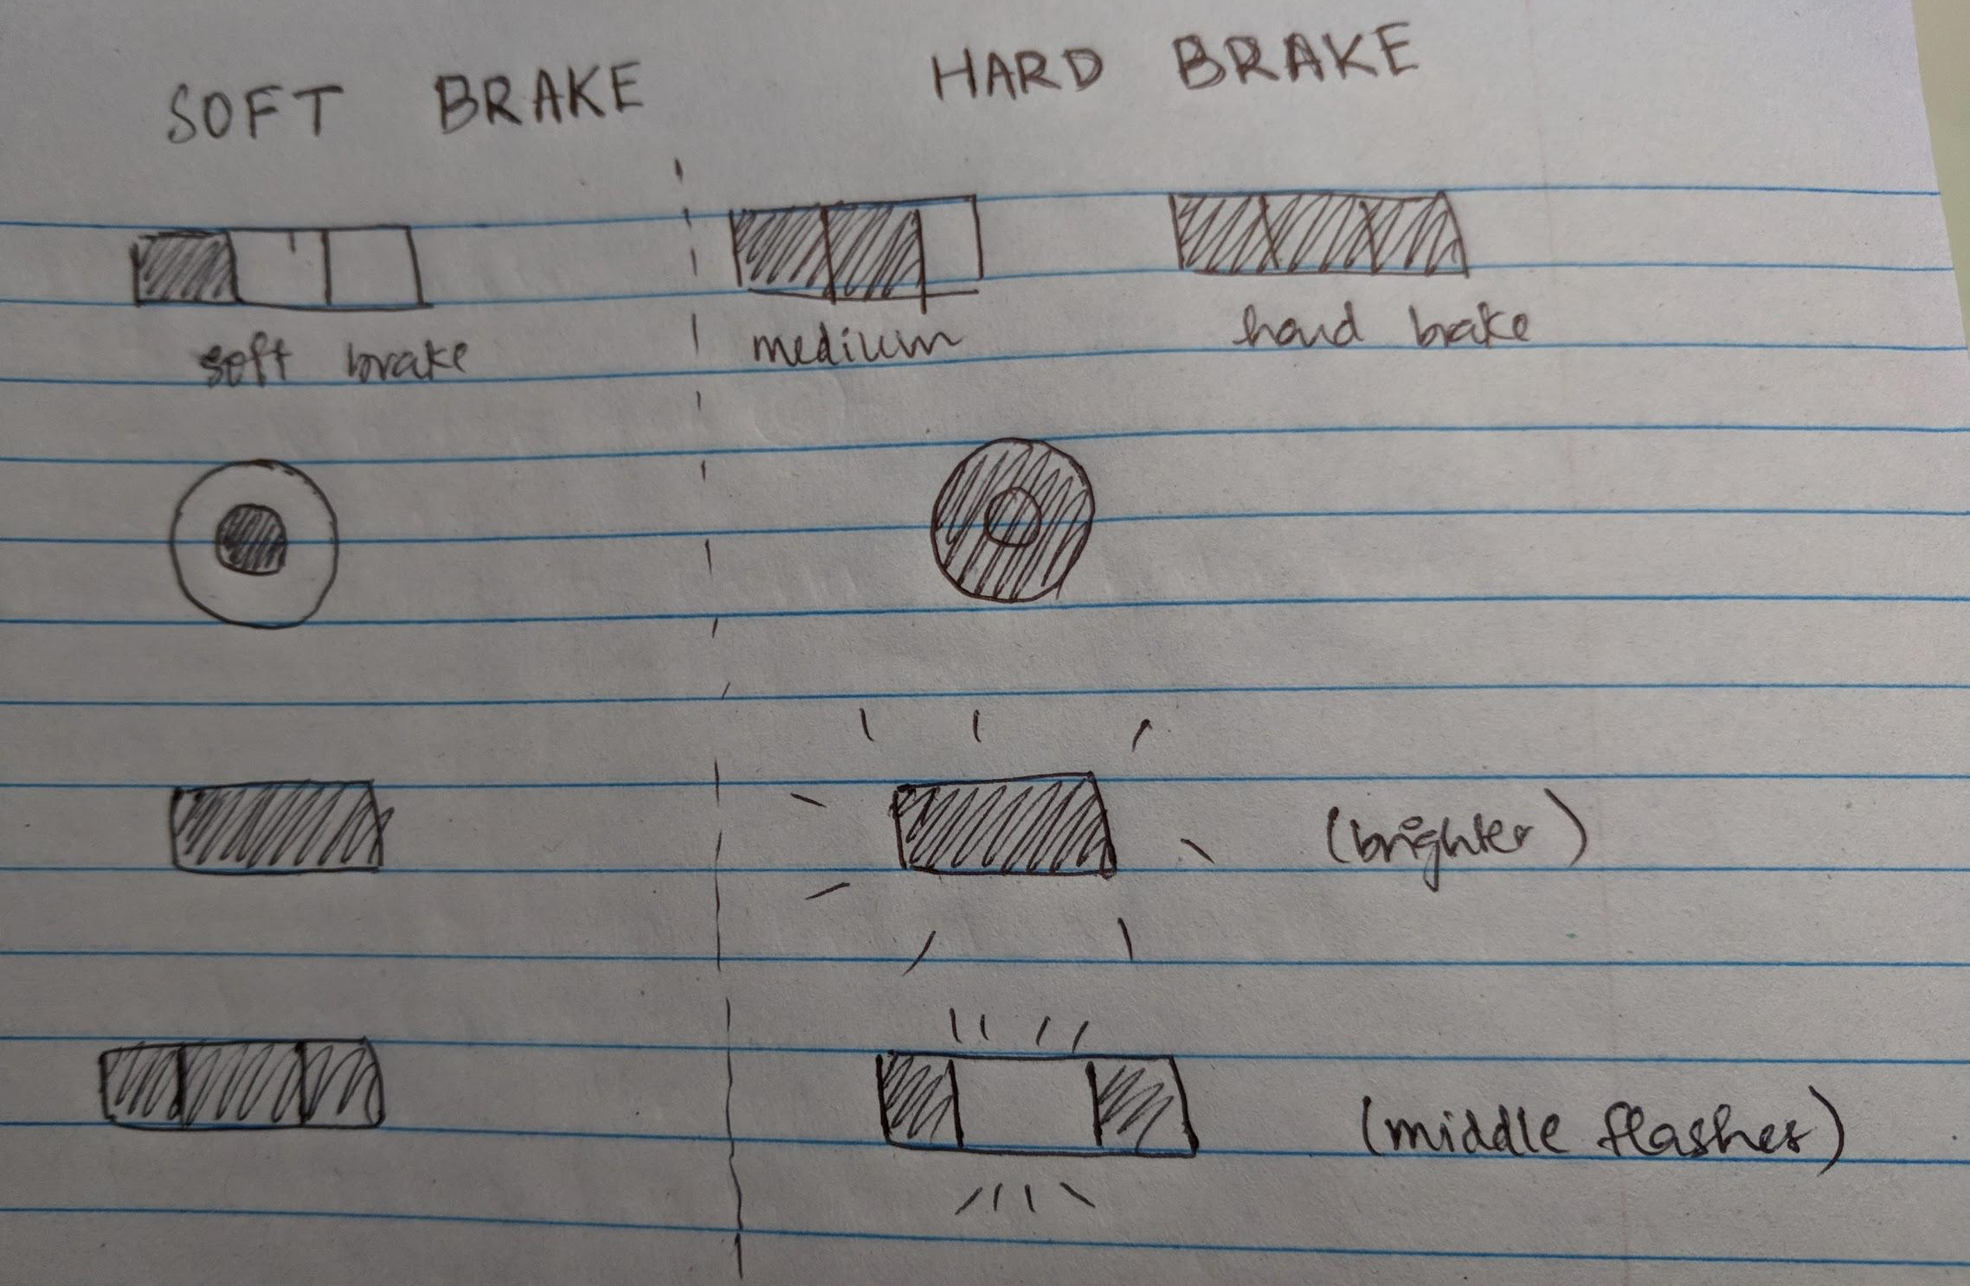
Development of the Brake Light Redesign

Slide 13
Aspects of Redesign
Larger
Brighter
Standardized look and location
Minor changes to existing model

Slide 14
Aspects of Redesign
Distinct mechanism for hard brakes
Middle part flashes
Emits an audible sound
Flashing and sound will help notify distracted drivers
Adding sound is more effective than just light in low visibility conditions
Major changes to existing model

Slide 15
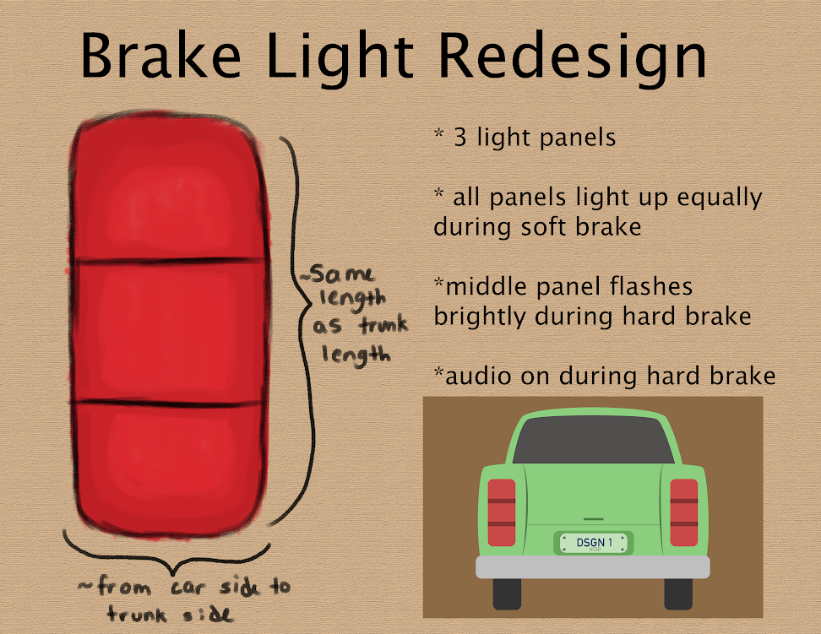
Prototype -Initial Sketch

Slide 16
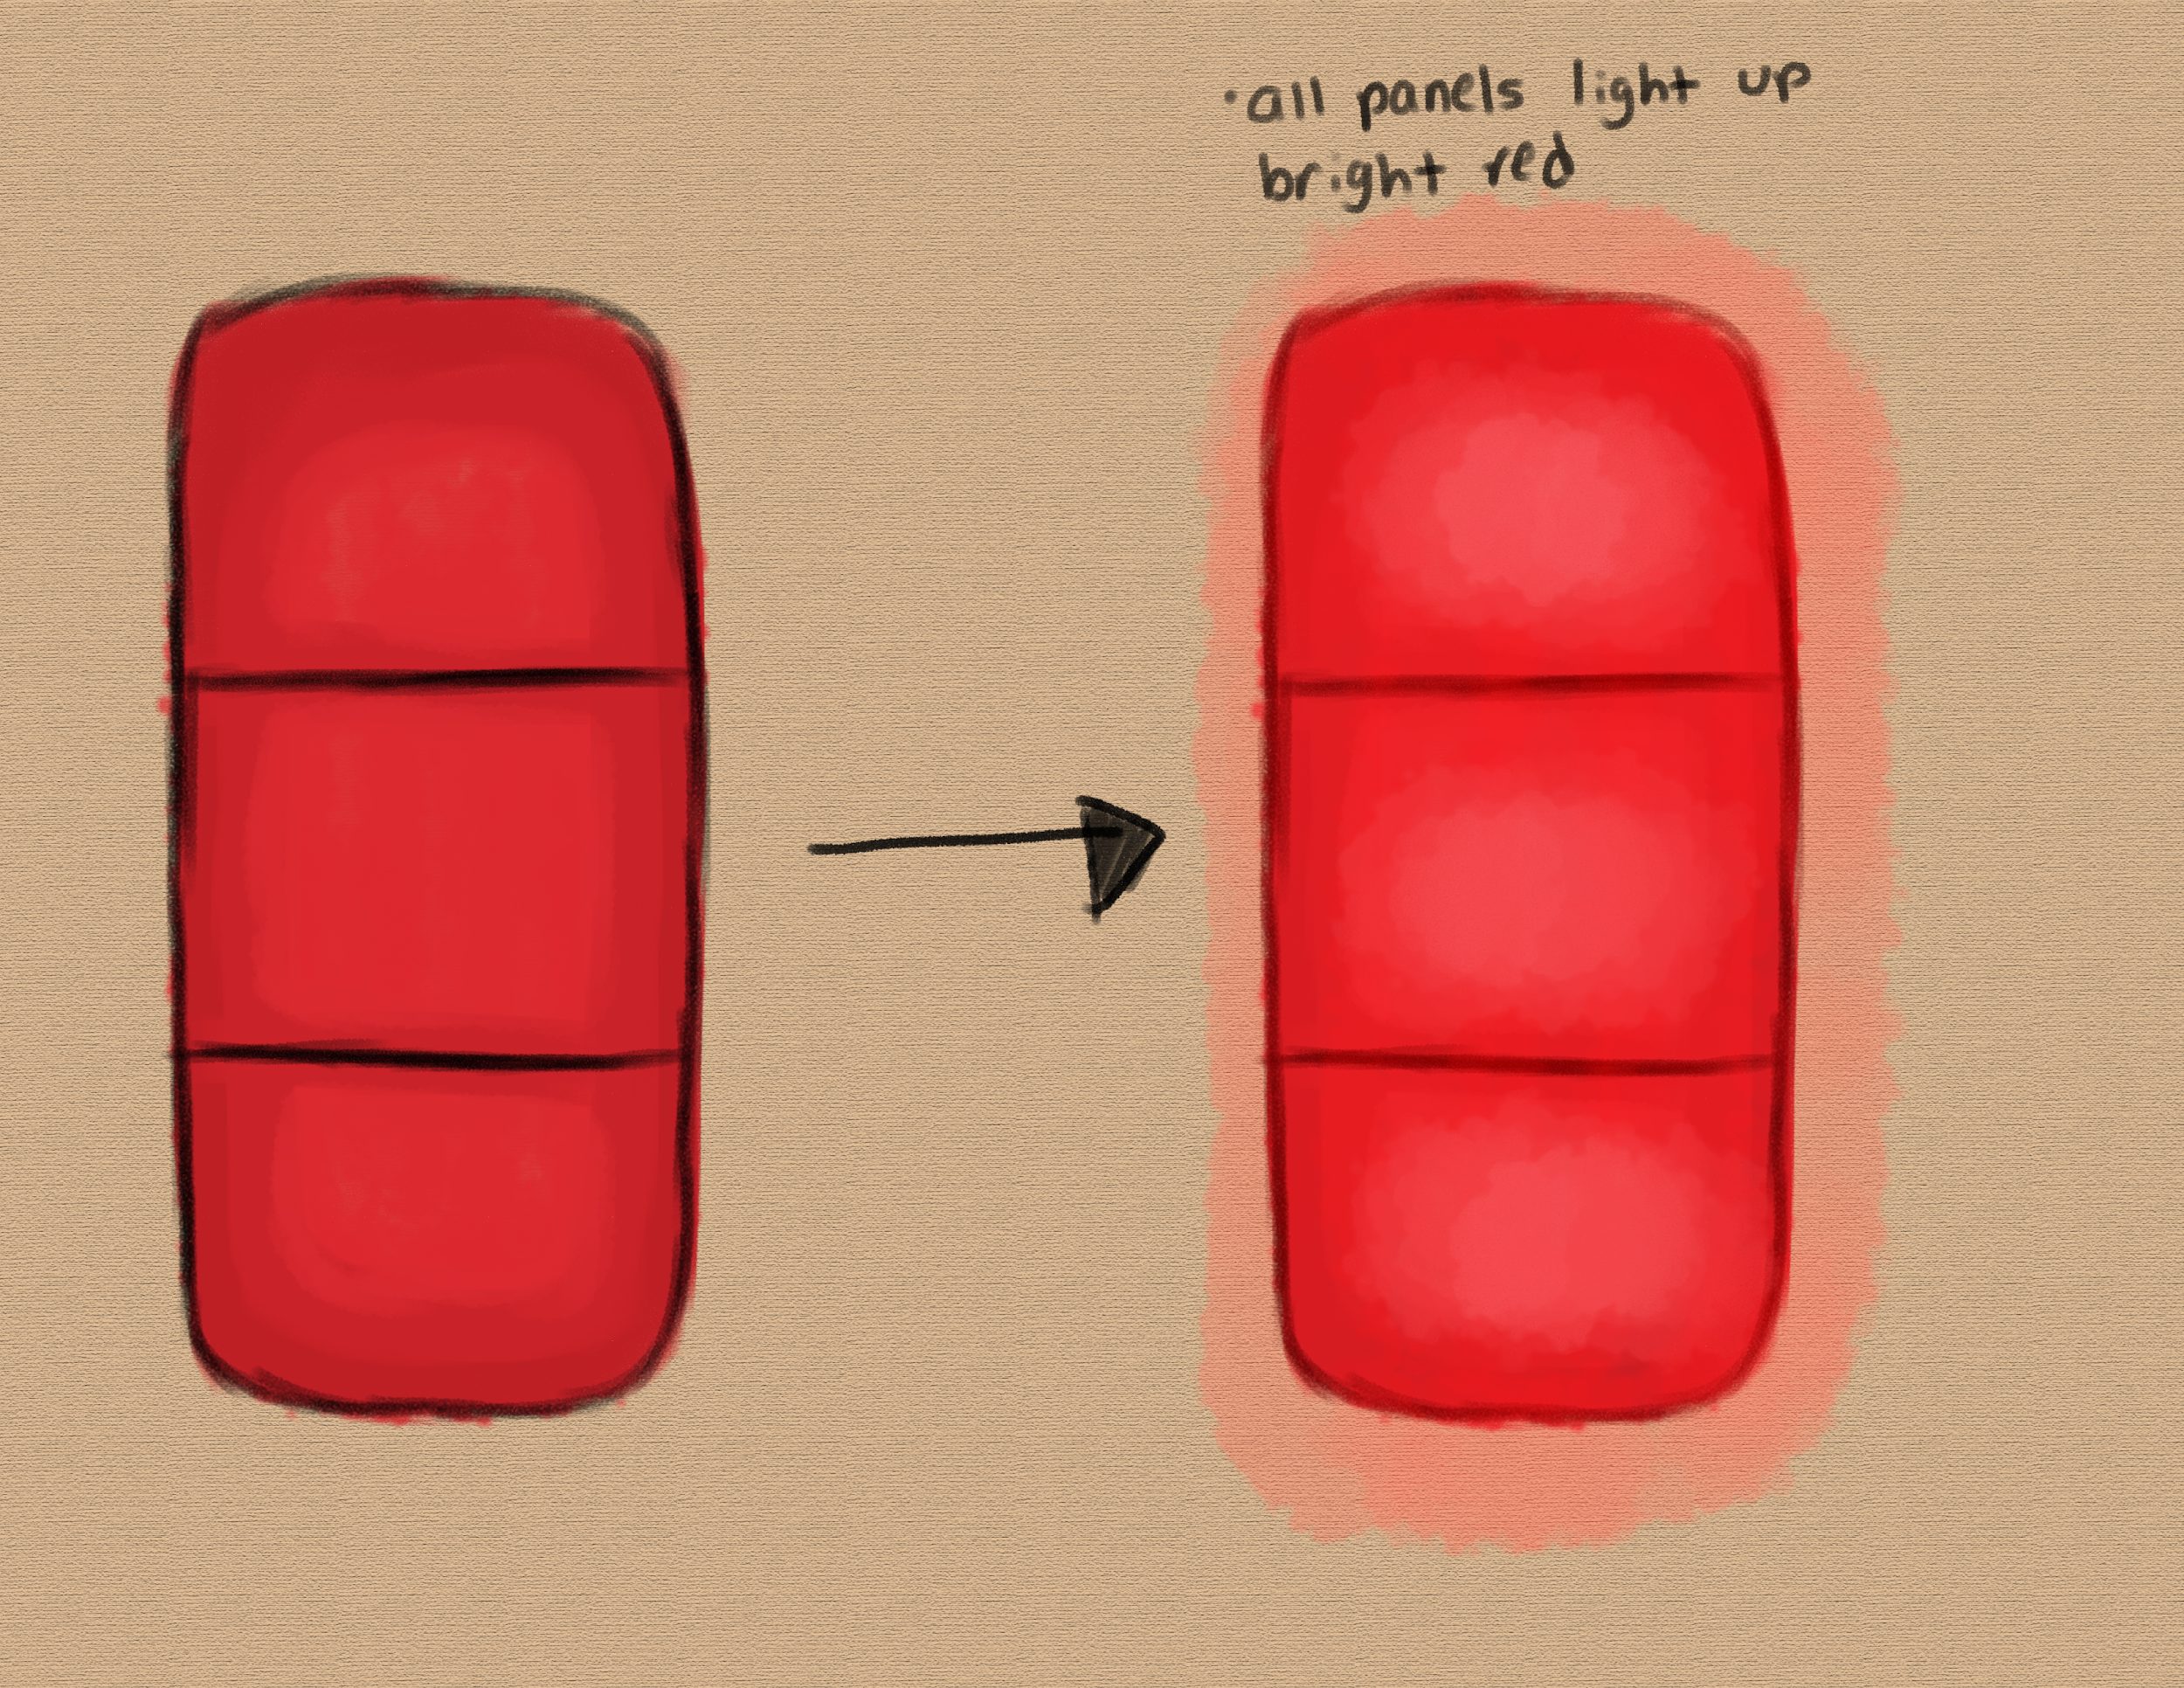
Prototype - Soft Brake

Slide 17
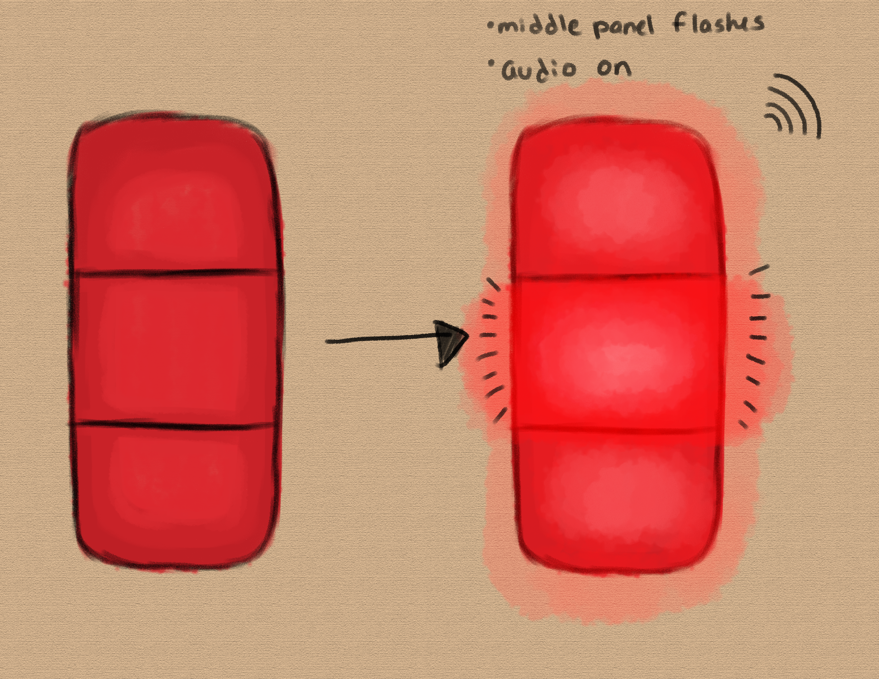
Audio
Prototype - Hard Brake

Slide 18
Trade-offs
Advantages
Visibility
Versatility
Distinction
Safety
Is the design really worth it?

Slide 19
Trade-offs
Disadvantages
Cost
Standardization
Lack of Personalization
Annoyance
Is the design really worth it?

Slide 20
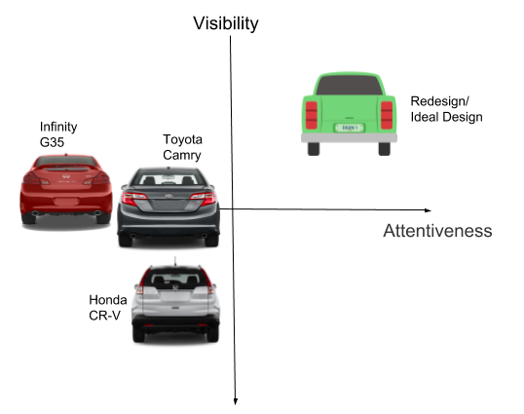
Visibility: How well can drivers see the brake lights
Attentiveness: How well do brake lights capture the attention of drivers
Our Design Space

Slide 21
Conclusion
Create a high fidelity prototype
Test with users and refine design, optimizing tradeoffs
Set a standard among manufacturers for design and location of brake lights
Expand design to all vehicles
May be difficult to change existing vehicles, but can become a standard over time
Where do we go from here?

Slide 22
Thank you!

